Slide 1



UNH SEDS
CEPS Engineering Organization
High Power Rocketry
University of New Hampshire
Students for the Exploration and Development of Space

Slide 2
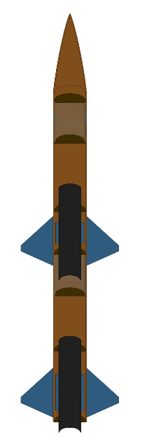


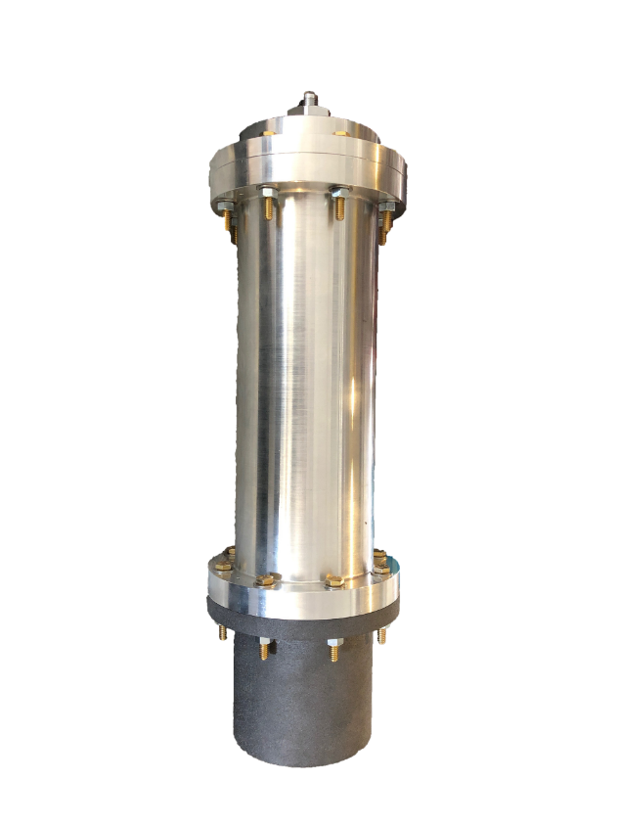
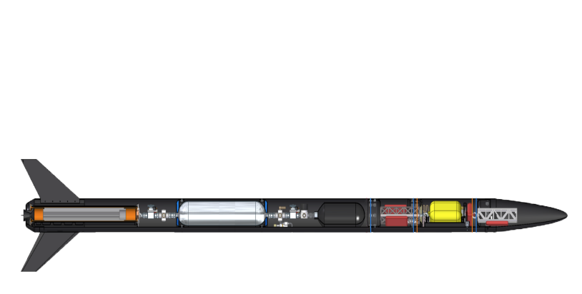

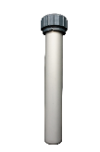

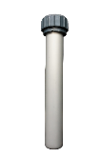
The Three Year Plan
Year One
2017-2018
Hybrid Engine
Design
Manufacture
Test
Year Three
Runaway
Rocket Building
Simulating
Launching
Optimizing
Hybrid Rocket
Engine Optimization
Rocket Integration
Competition
Year Two
University of New Hampshire
Students for the Exploration and Development of Space

Slide 3

University of New Hampshire
Students for the Exploration and Development of Space

Slide 4
Project Overview
Design and test a hybrid rocket for Spaceport America Cup
Propulsion
Frame
Avionics/Payload/Recovery
Operations
Research thrust vector control on COTS engines
Feedback and Control
Mechanical Design
University of New Hampshire
Students for the Exploration and Development of Space

Slide 5
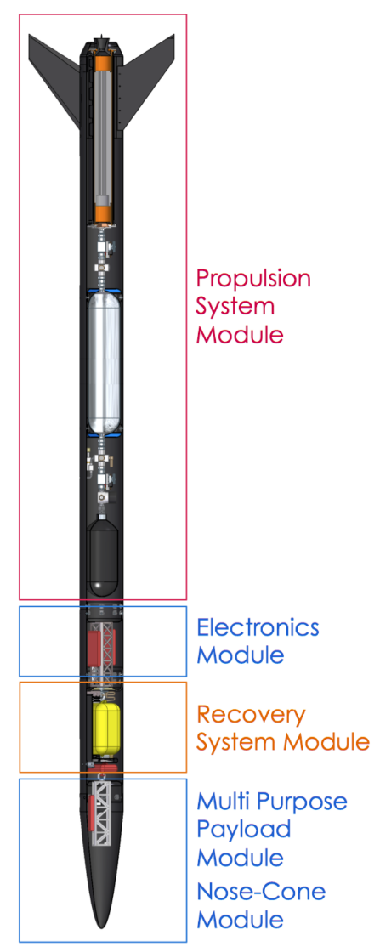
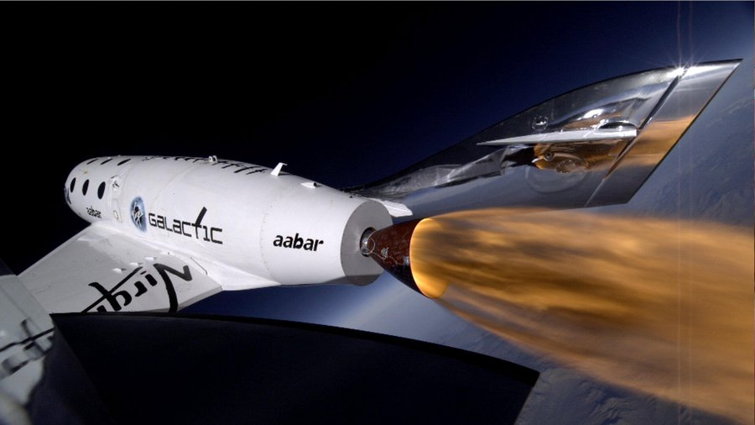
What is a Hybrid Rocket Engine?
Rocket is propelled via solid and liquid components
HTPB Rubber fuel (maybe paraffin in the future)
Nitrous Oxide oxidizer (car nitrous)
Combines safety and simplicity of a solid motor with some aspects of liquid engines, i.e. throttle-ability
Virgin Galactic’s SpaceShipTwo!
University of New Hampshire
Students for the Exploration and Development of Space

Slide 6
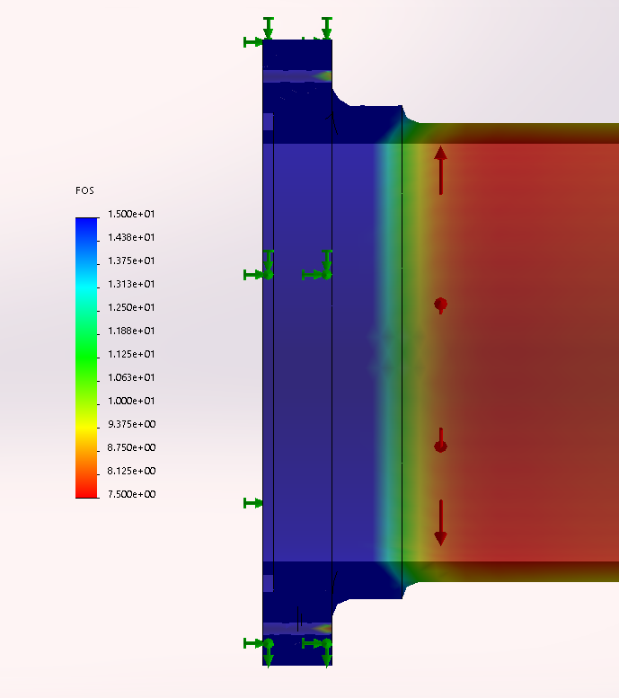
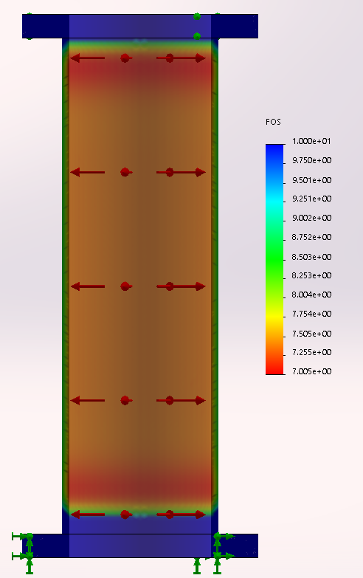
Propulsion Team
University of New Hampshire
Students for the Exploration and Development of Space

Slide 7
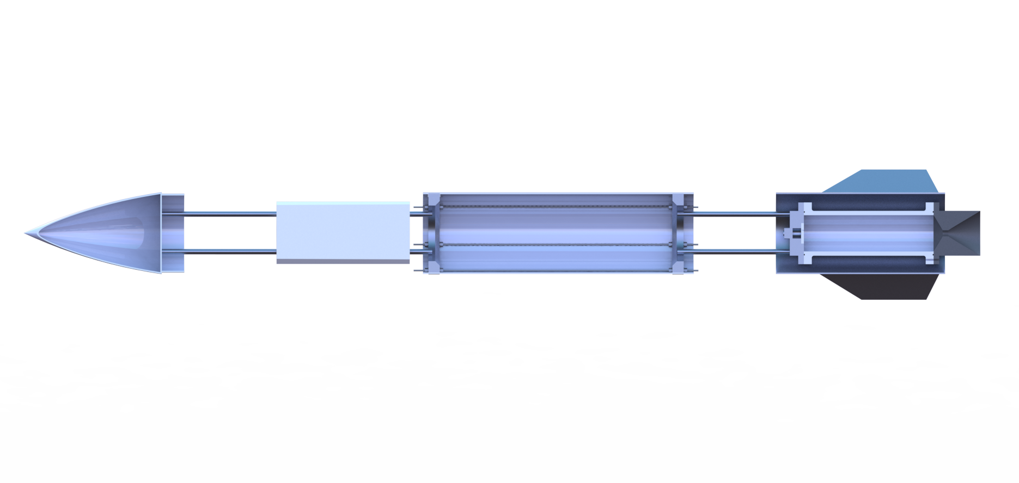
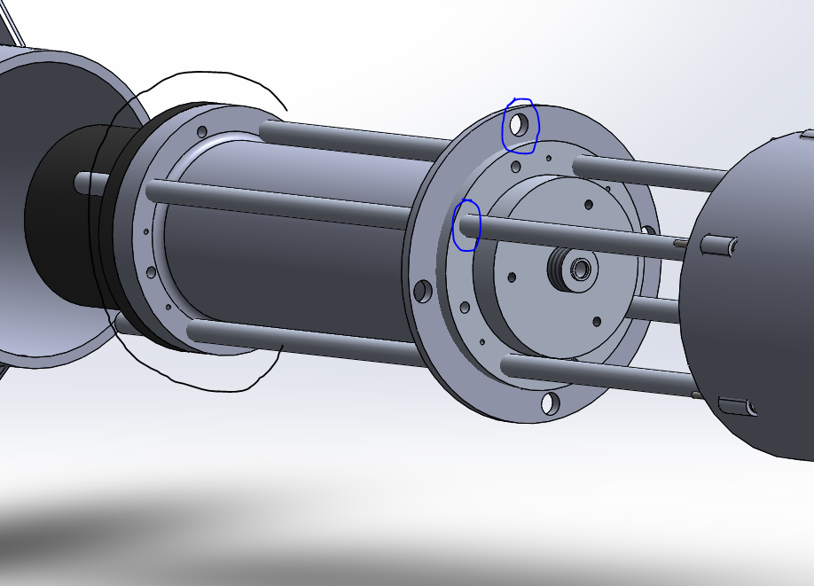
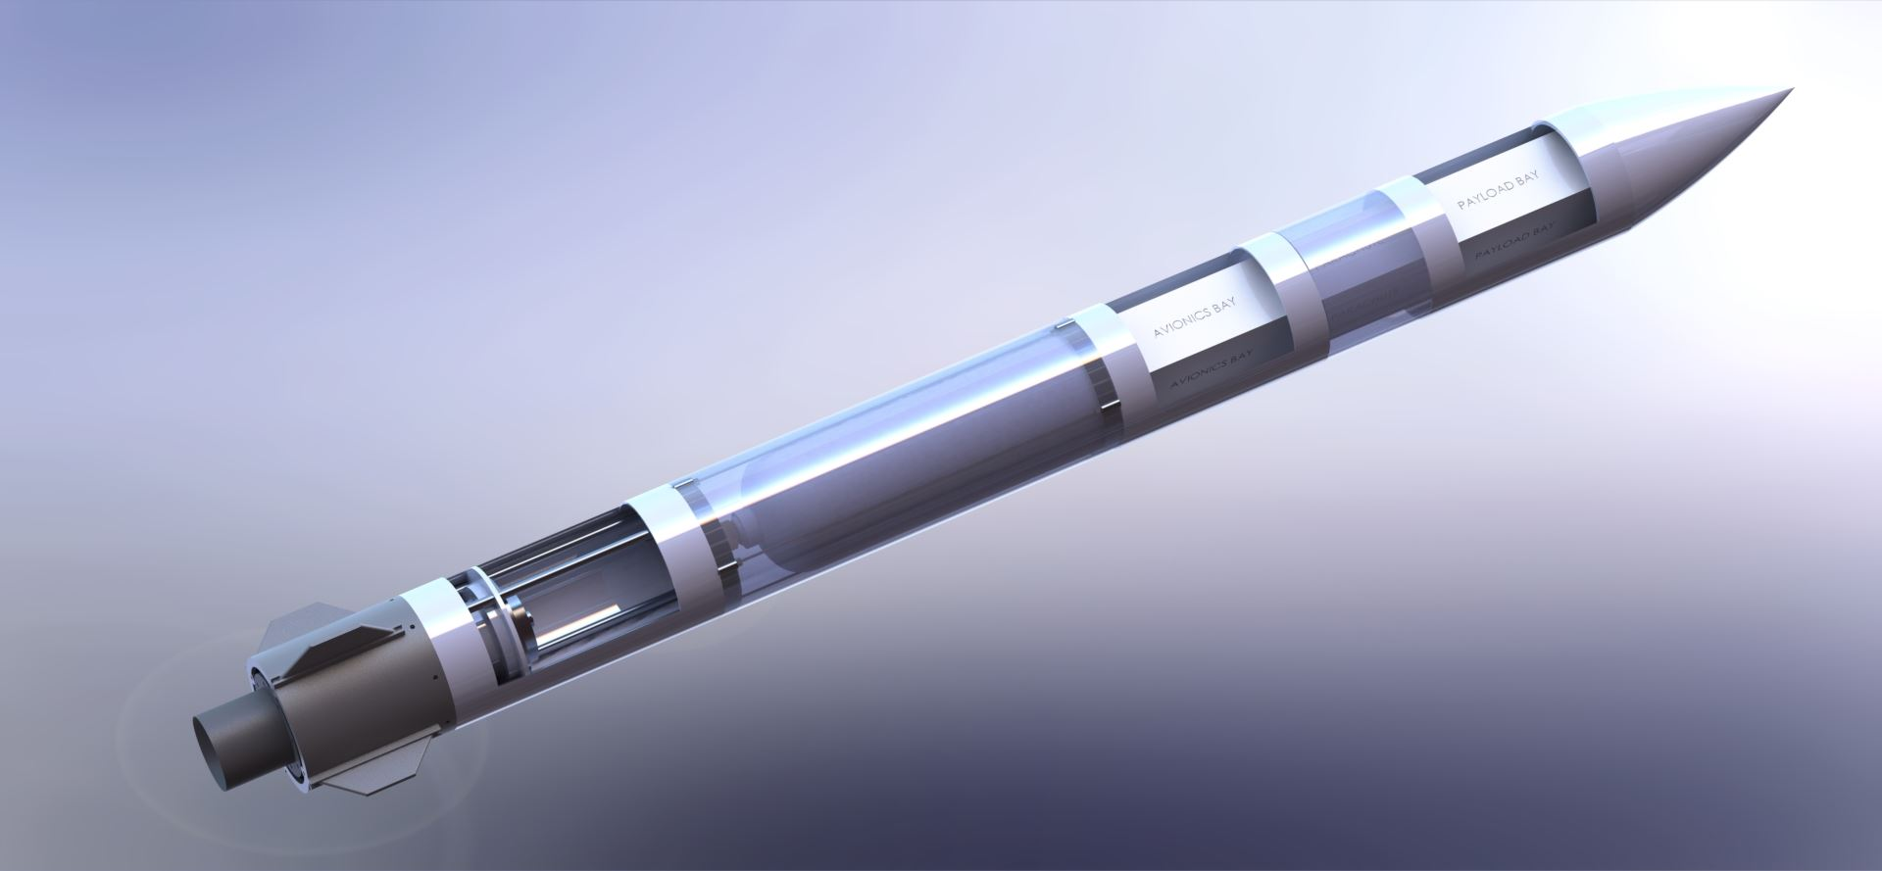
Frame Team
University of New Hampshire
Students for the Exploration and Development of Space

Slide 8
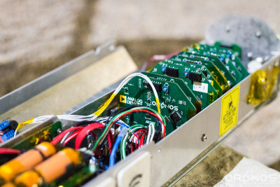
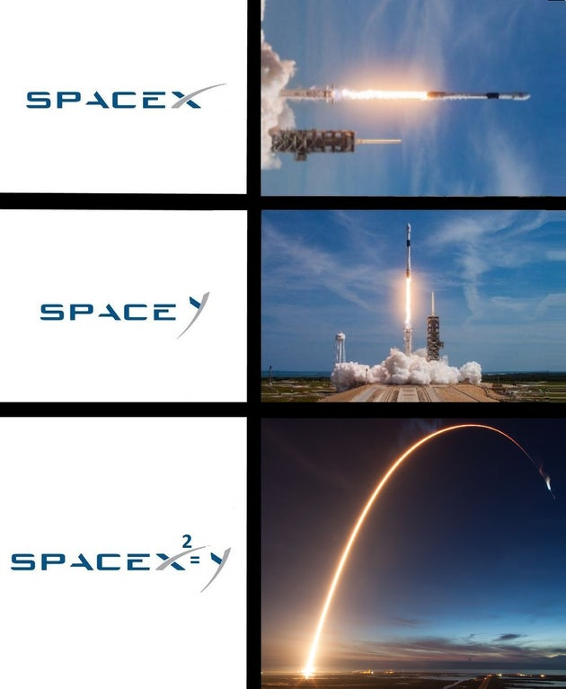
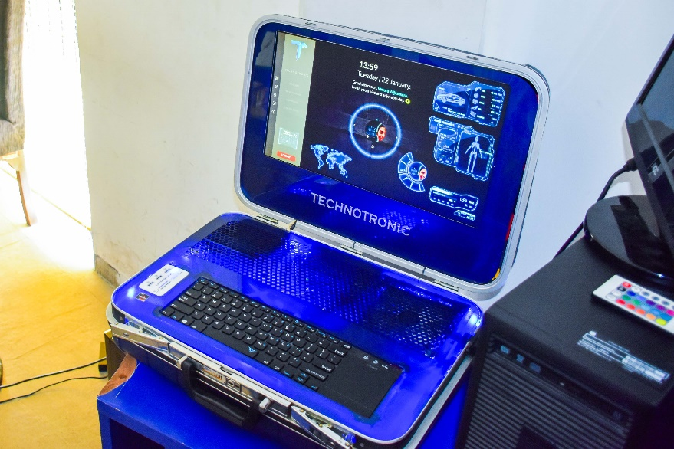
Avionics/Payload/Recovery Team
Electrical system of Rocket
Launch Control Module
Live data communication
GPS tracking
University of New Hampshire
Students for the Exploration and Development of Space

Slide 9
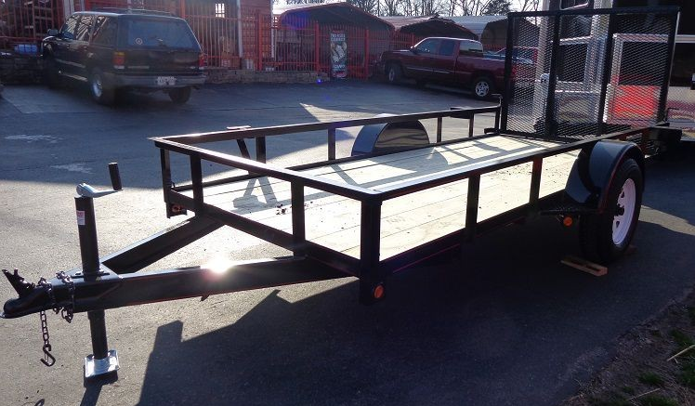
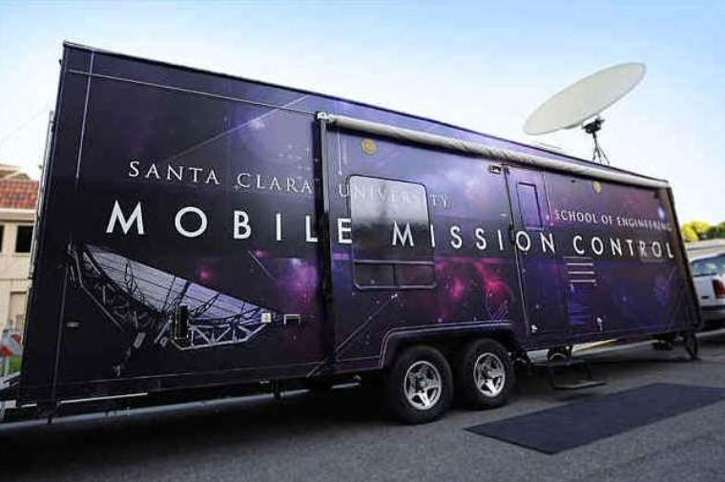
Operations Team
In charge of all Spaceport coordination and requirements
Engineering integration and systems engineering
Responsible for coordinating tests
Safety
Aid in all engineering-related activities
University of New Hampshire
Students for the Exploration and Development of Space

Slide 10
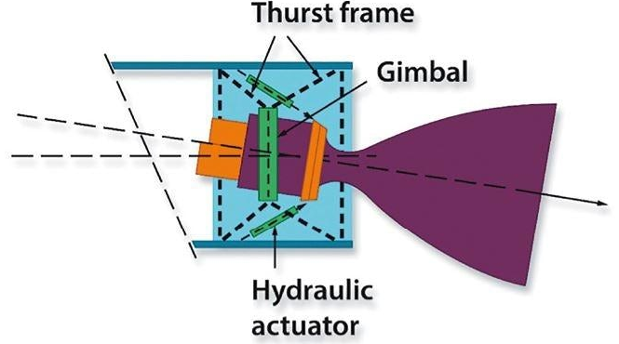
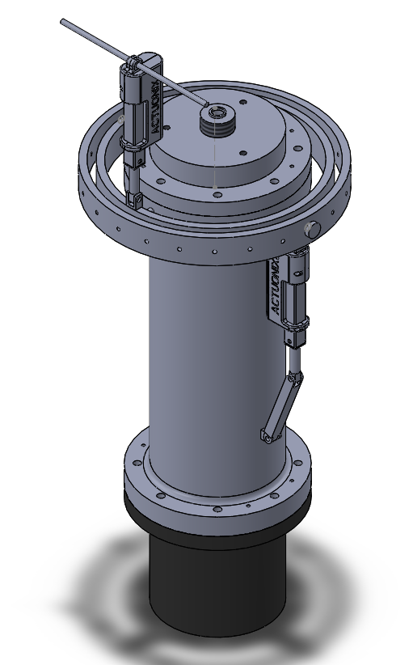
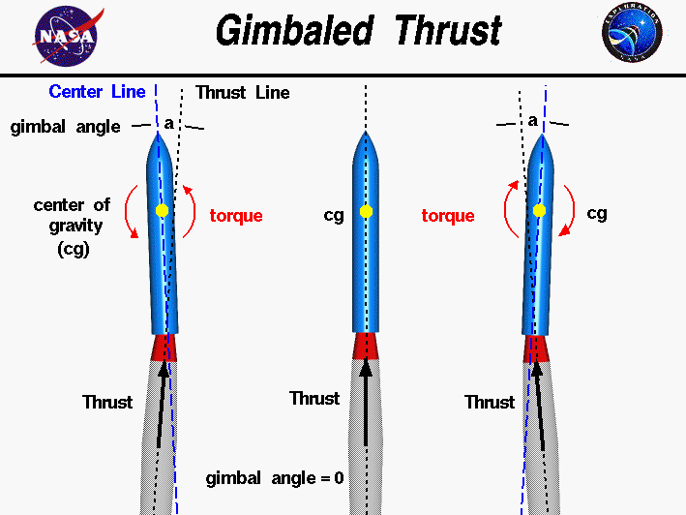
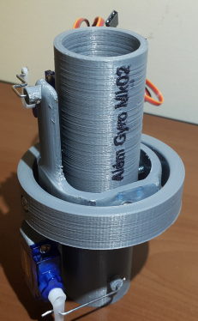
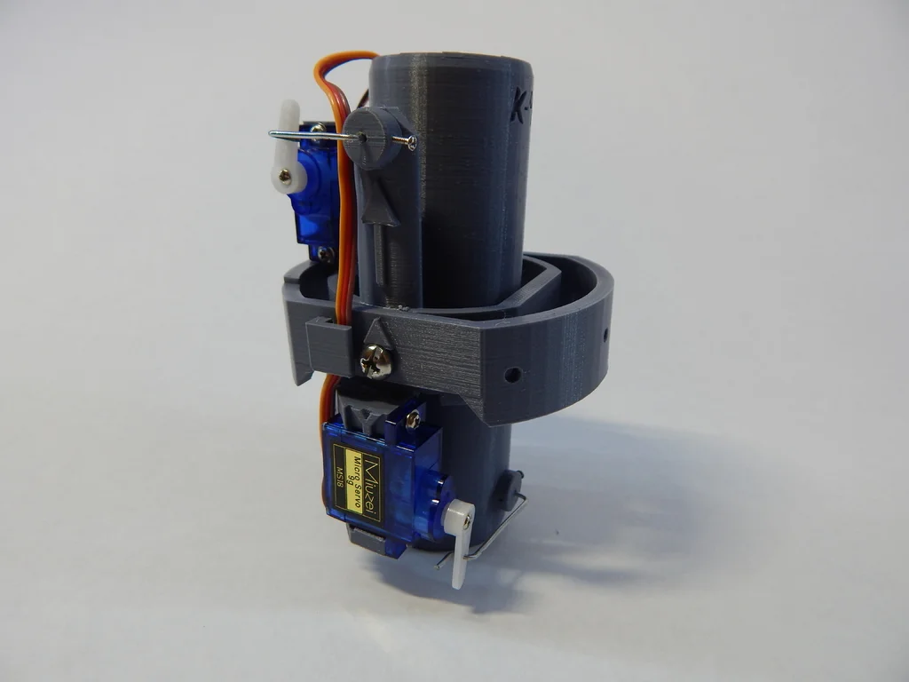
Gimbal System
Control the direction of thrust and the orientation of the rocket
First step towards following predefined flight trajectories
Project Tasks:
Measuring system parameters
Numerical modeling
Gimbal hardware design
Control algorithm design
Static testing of stability
Flight implementation and testing
University of New Hampshire
Students for the Exploration and Development of Space

Slide 11

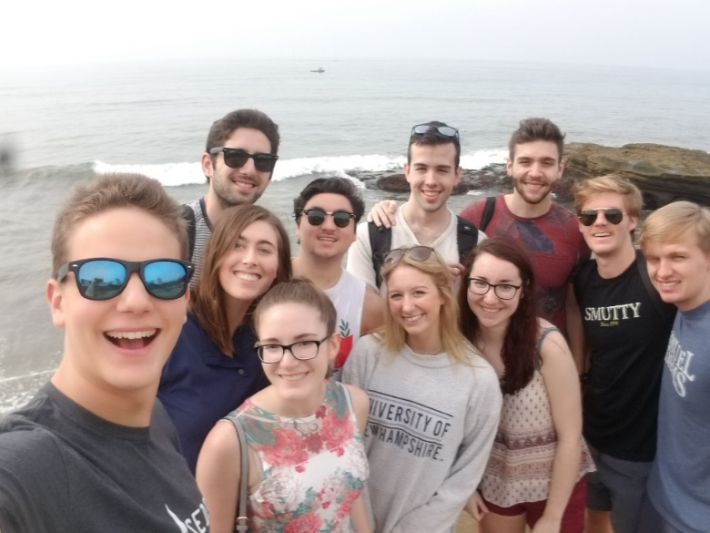
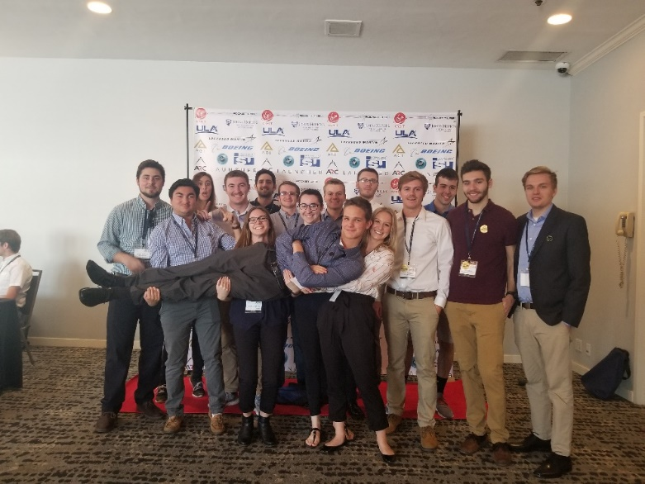

How Can You Help?
Looking for students who’d be willing to help with CAD modeling of rocket components in frame, propulsion, and other needs that come up.
Students interested in learning SolidWorks CAD, FEA, and FlowSimulation
Integrate into one of our teams, given a modeling project to complete and aid our senior project.
Good experience to integrate into a team as a freshman.
If interested, contact me at sgj1001@wildcats.unh.edu (Silas Johnson – Mechanical Engineering Project Manager)
@unhseds
University of New Hampshire
Students for the Exploration and Development of Space
Notes:
EE major too

